Slide 1
Wheel's,Up Home automobile Service
Askar E Z
Vibhish R
Vigneshrajan S

Slide 2
AGENDA
Abstract
Problem statement
​Proposed solution
System Architecture
​Analysis and Findings
Output Screenshots
GitHub Link
Conclusion
References

Slide 3
Abstract
Our Project approves presenting car and Bike service at the door-step. If consumer obtained any hassle with his automobile based totally on assurance card, they are offering services.
The actual energy of this mission lies now not in direct promoting of products, however in the advent of tighter relationships with clients and handing over of an excessive stage of carrier and support, which in flip improves employer income and its goodwill.
A provider organization is a commercial enterprise entity that takes care of servicing a purchaser instrument in the after-income domain.
As the variety of clients and dimension of operations increases, the organization divides the geographical place into provider areas and department locations, to enable Engineers to be greater responsive to the customer-needs.
Our Aim is to ease the customer problem and have a friendly response to their query at their convenience.

Slide 4
Problem Statement
As you know it is tedious and annoying to have a breakdown or repair in our car or bike when you are reaching somewhere urgent. In general, we have to go to a mechanic shop or call him and he may be not available at the time we need him.
Today we have everything at the disposal of our hand and is even available at our door-step from clothes, meat and even pets which we generally call E-Commerce but why not the service we required for our vehicles at our door-step......?
Above problems can be seen as from point of view from a customer but what from the service provider it is not easy to just provide service right so what we can do to ease their side of inconveniences and issues.
From a service provider view other than providing a service he has to maintain the logs and record of services and sometimes in case of any issues he has to cross-check the records from the pile which is not easy and lot more tedious work to go.

Slide 5
Problem Statement
What we know from this:
From first point, it is clear that a handy service for automobile is not available for customer at their convenience.
Then even though we can call a repair service there isn’t a proper flow all the time and it is not guarantee that we can reach to them all the time.
As from service provider side, fetching and storing customer details from the pile of record and keeping track of work is not easy and tedious.
Next, we will see the possible solution to problems mentioned above.

Slide 6
Proposed Solution
What we propose is to give customer the needed service at their Doorstep and their convenience.
For which we provide a user-friendly interface with the features intended with a database which is convenient for service-provider let's see the actual process and logic involved behind them.
Business Logic:
We have divided the logic into 3 modules:
User Registration
Services Needed
Booking Module

Slide 7
User Registration: As there is need to store the data for users so there is necessity for them to register and log-in to home page in order to access the further service and assistance. This also serves as a security purpose for user’s confidentiality and ease in storing data which can convenient for service provider.
Services Needed: Then comes the main part which will be the service from which customer can select their desired service depending on their need and also if there are is any query which is not addressed in our service then the customer can also use our Live-chat feature to address their query which we will respond immediately to help at their convenience.
Booking Module: Then comes the final step which is booking the service the customer opted which is done through getting their address, mobile no, vehicle type, manufacturer and model. Then after booking they can see their booking preview in order to know what is happening.

Slide 8
DATA REQUIRED:
THIS PROCESS IS DONE DURING BOOKING DURING WHICH WE GET USER’S DATA LIKE VEHICLE TYPE, VEHICLE MANUFACTURER, VEHICLE MODEL AND VEHICLE FUEL.
WHICH HELPS IN IDENTIFYING THE DATA OF THE USER AND IS USEFUL WHILE PROVIDING SERVICE.
DECISION MADE BASED ON THE OUTPUT:
WHAT WE CAN DERIVE FROM THIS IS THAT DATA RETRIEVED CAN BE USED FOR FUTURE ANALYSIS OF THE PROBLEM WITH THE SAME USER OR ANY OTHER USER WITH THE SAME PROBLEM.
THE MAJOR ADVANTAGE OF THIS IS THAT IT IS CONVENIENT FOR USER TO ACCESS THE SERVICE ANYTIME EVEN DURING THE EMERGENCY TIME THE SERVICE CAN BE ACCESSED EASILY.

Slide 9
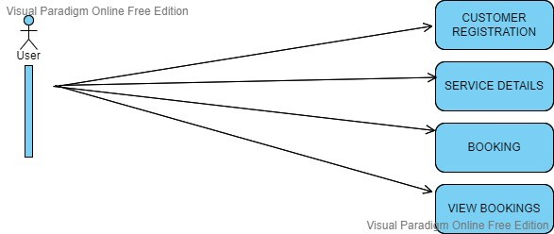
System architecture
User case

Slide 10
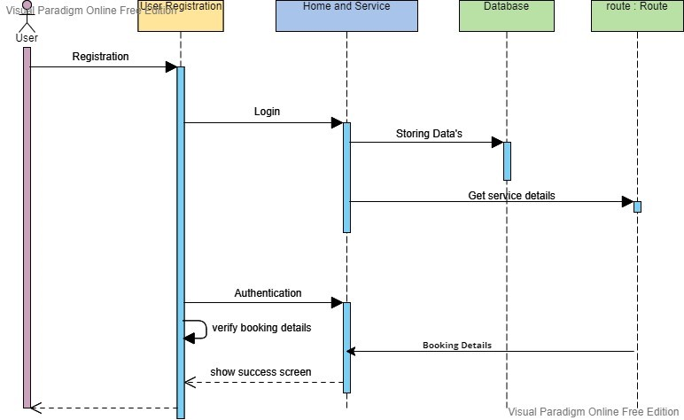
System architecture
Sequence diagram

Slide 11
Analysis and Findings
Request and Response time with Remarks:
ACTIONS - DURATION – REMARKS
Request sent - 0.13ms - Average
Server Response - 2.28ms - Fair
Content Download - 0.21ms - Good
USER-INTERFACE - RATING (rated by users)
Site Responsiveness - 4/5
Site Features - 3/5
Site Expectedness - 5/5
User Satisfaction - 4/5

Slide 12
Analysis and Findings
IMPROVEMENTS THAT CAN BE DONE:
A tracking feature can be added so that customer can know when their mechanic will arrive.
24/7 Assistance can be included which can be used during sudden breakdown or need of any assistance of repair during emergency.
Online Payment can be added in future updates for convenient payment for users.

Slide 13
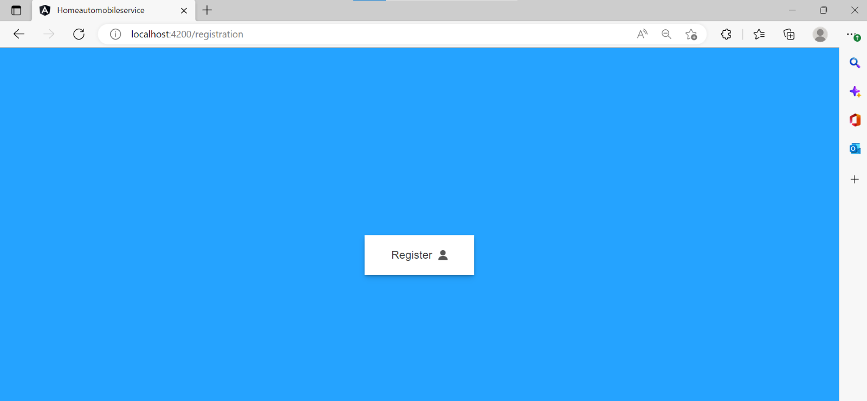
Output
Registration Page:

Slide 14
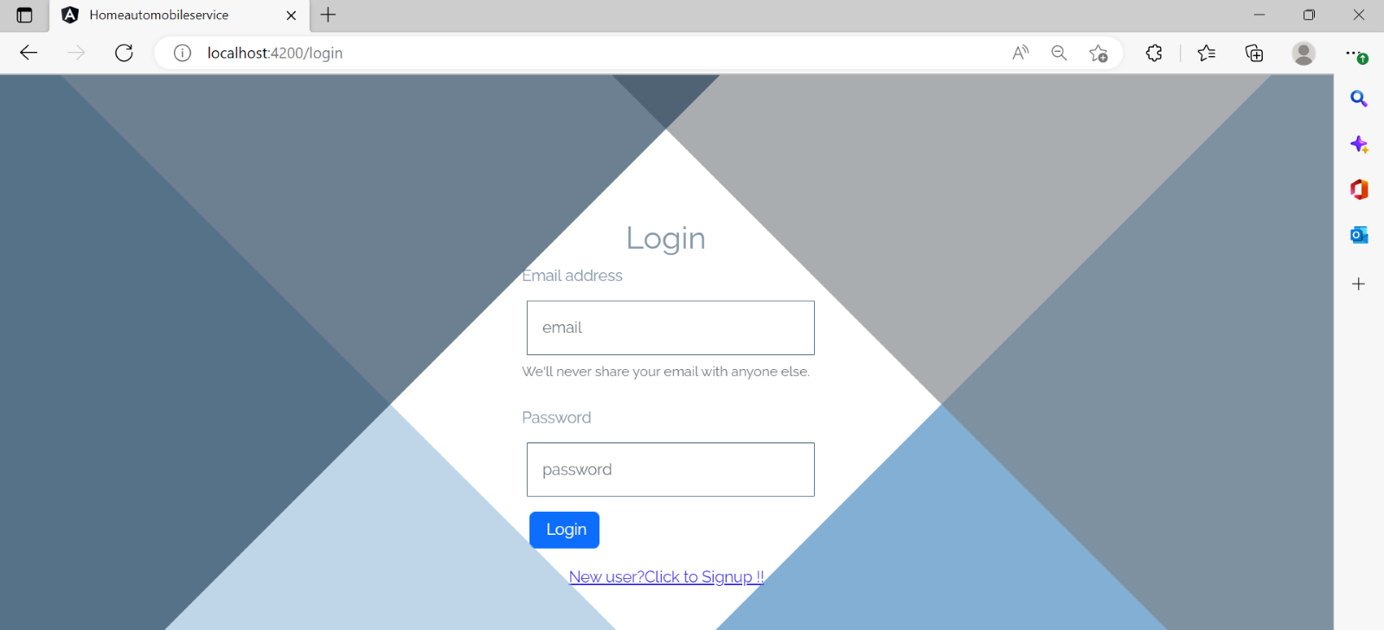
Output
Login Page:

Slide 15
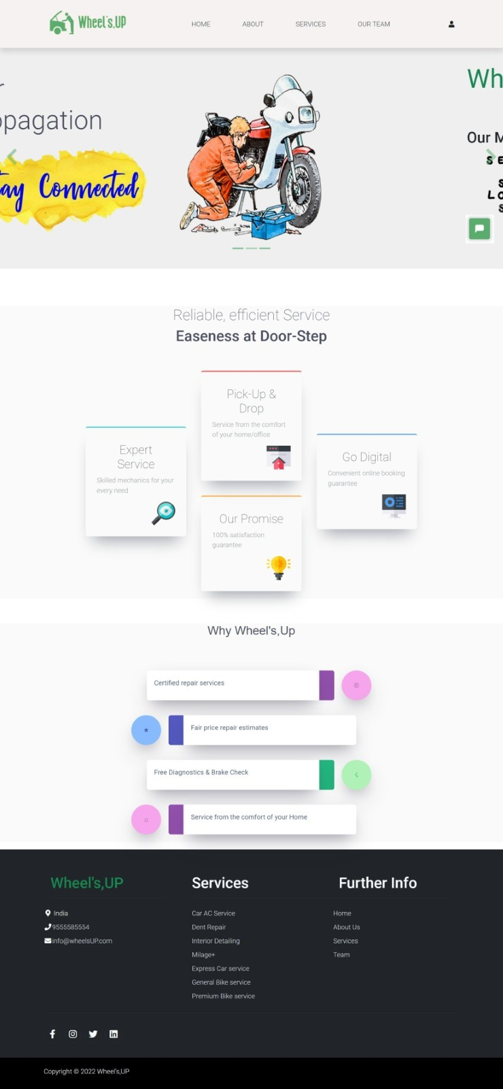
Output
Home Page:

Slide 16
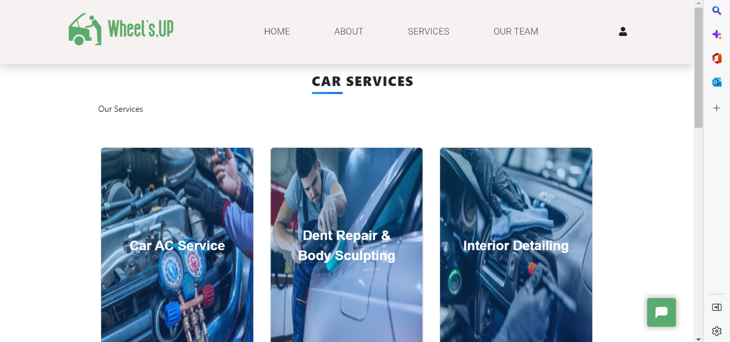
Output
Services Page:

Slide 17
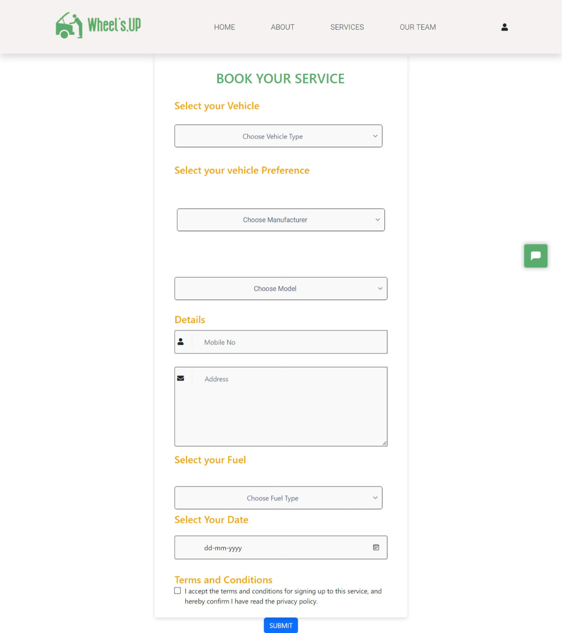
Output
Booking Page:

Slide 18
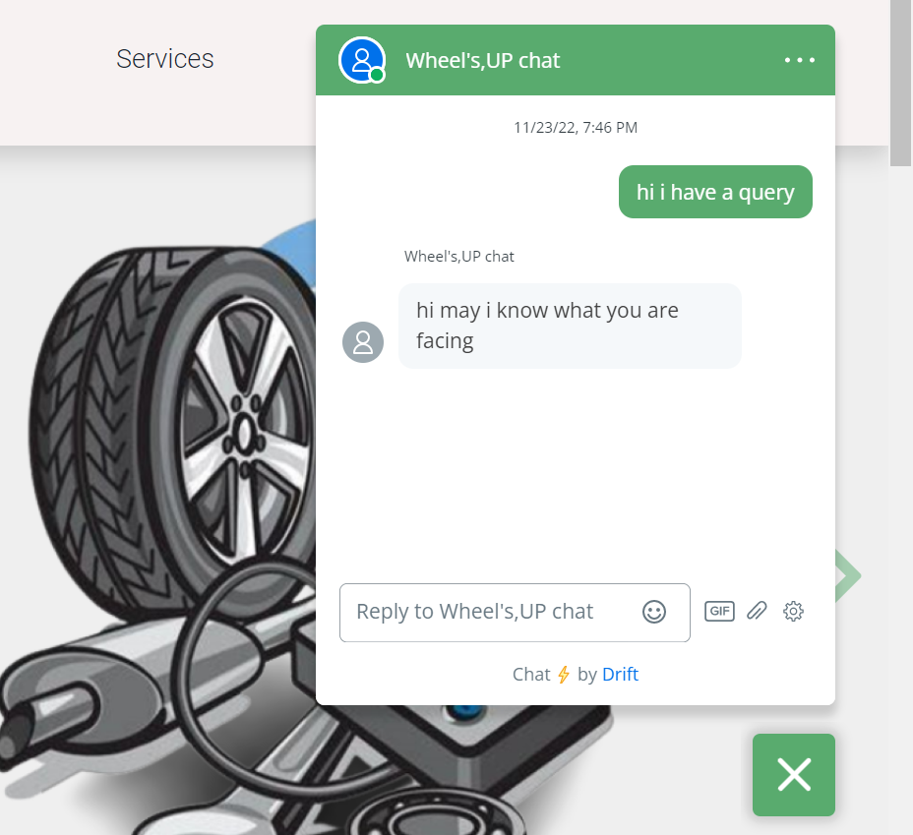
Output
Live Chat:

Slide 19
GitHub link
https://github.com/vigneshrajan2001/Wheel-s-UP---Home-Automobile-Service.git
conclusion
Our project enables the users to book their services from the comfort of their home in a much faster and easier way.
• provide various kinds of services for both bike and car and also an interactive live chat for the customer to ask their queries.
• Through this we can establish a healthy relationship with customer by providing them services faster at their convenience anytime on their likes.
• This also helps in keeping tabs on databases which can be used as references for future queries and issues.

Slide 20
referneces
1. To know more visit: https://freefrontend.com, “CSS - Examples”
2. Visit: https://www.britannica.com, “Automobile | Facts, industry etc.”
3. Visit: https://www.otobots.com, “Mobile Mechanics”
4. Gilles, Tim (2004). Automobile Service: Inspection, Maintenance, Repair. USA: Delmar Learning.pp. 16-23.
5.” Independent garages and the motor Vehicle Block Exemption”. UK Government. Retrieved 24 October 2012

Slide 21
THANK YOU

